Slide 1

Software Testing and Quality Assurance
Testing the Sentiment Analysis Code
SE463
Presented by:
Jana Aldubai
Salwa Shamma
Samah Shamma
Sana Shamma
Dr. Ftoon Kedwan

Slide 2
Agenda
Open-Source Testing Tool
01
Project Idea & Objective
03
Manual Testing
Analysis & Discussion
02
04
Experiment
Experiment
Outcome

Slide 3
Introduction
Project Idea and Objective...

Slide 4



Project Idea
Sentiment analysis program
Classifies the sentiment into positive, negative, or neutral categories.
Provides statistics and random emojis that indicate the overall sentiment of a given text.

Slide 5
Objectives
01
02
03
Apply testing techniques for designing test plan.
Conduct test coverage on a specific piece of code (statement, branch, Condition )
01
02
Perform test coverage both manually and automatically.
03
Compare the differences between manual test coverage and automated test coverage.
04

Slide 6
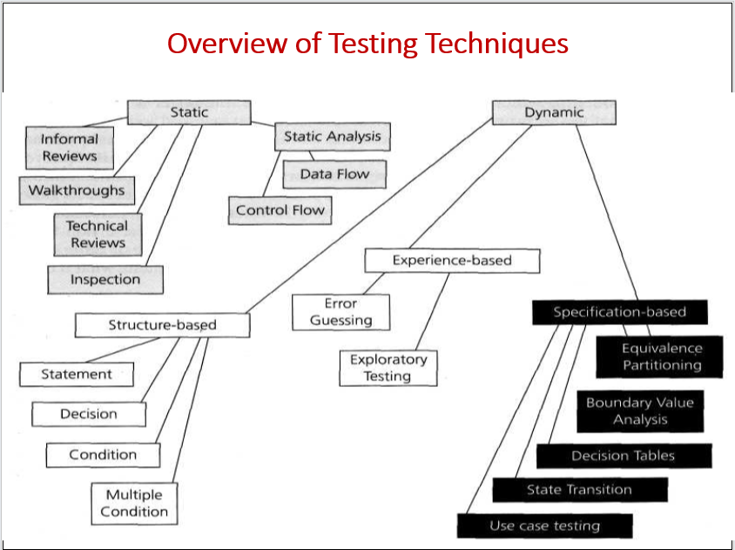
Testing Plan
Software Testing Planning
Time, Effort, Resources…

Slide 7
Manual Testing

Slide 8
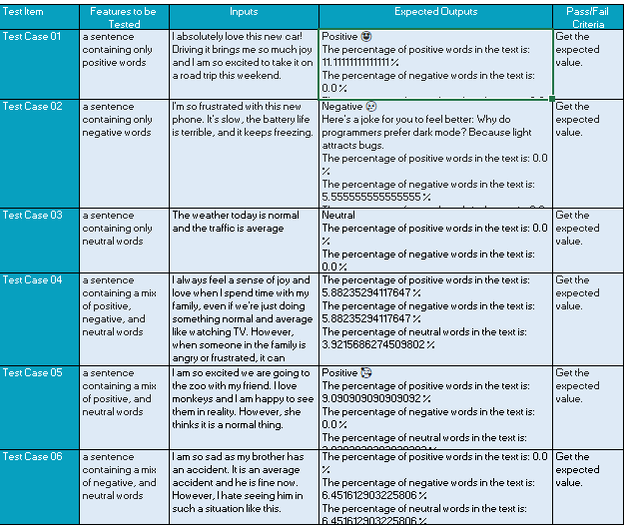
Test Cases

Slide 9
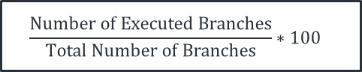
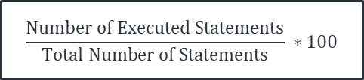
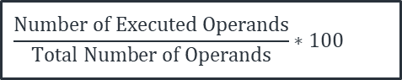
Statement Coverage:
Types of Coverages
Branch Coverage:
Condition Coverage:
$$\frac{Number of Executed Statements}{Total Number of Statements} ∗100$$
$$\frac{Number of Executed Branches}{Total Number of Branches}∗100$$
$$\frac{Number of Executed Operands}{Total Number of Operands}∗100$$

Slide 10
Open-Source Testing

Slide 11
Coverage.py
Coverage.py is an open-source tool used for measuring statement and branch coverage during software testing, and it supports various testing frameworks, like including pytest, unittest, and nose

Slide 12
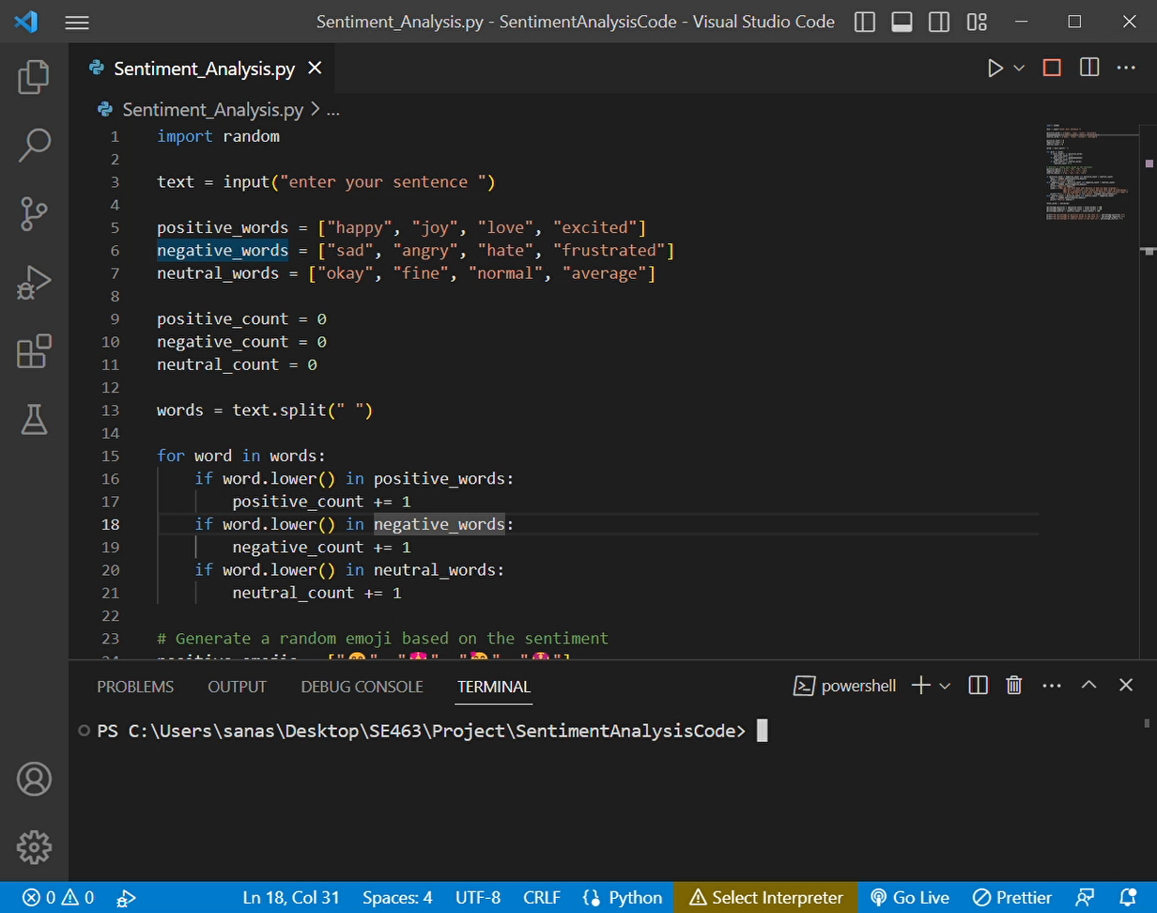
Open - Source Statement Coverage
Steps:
1- Coverage run FileName.py
2- Coverage report

Slide 13
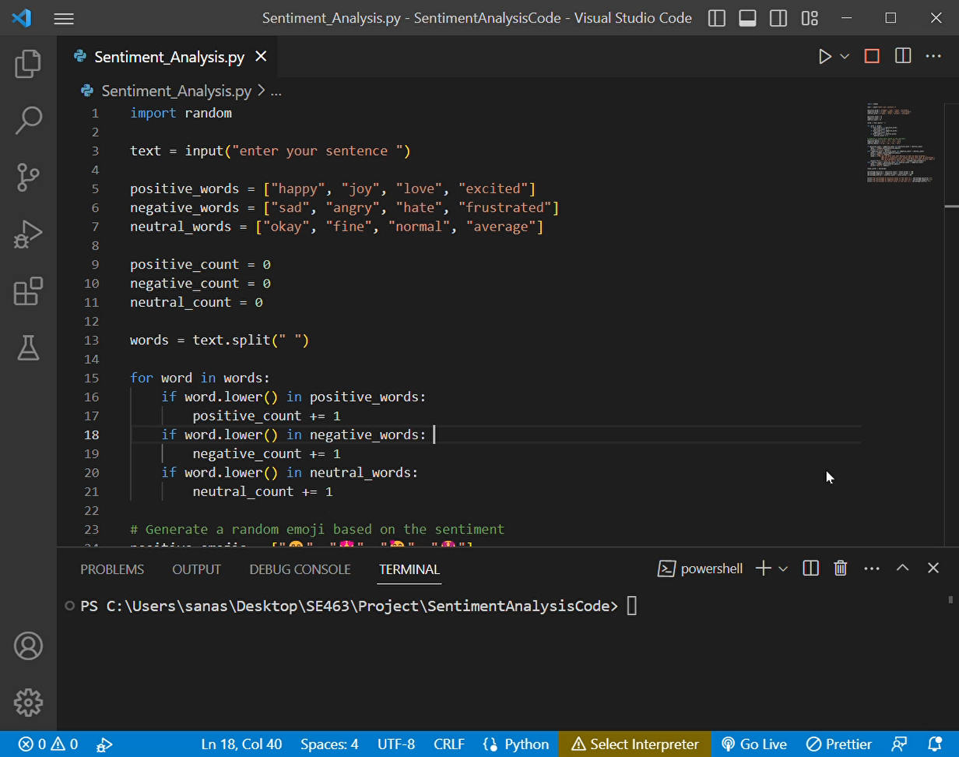
Open - Source Branch Coverage
Steps:
1- Coverage run --branch FileName.py
2- Coverage report

Slide 14
Conclusion
Analysis & Discussion

Slide 15
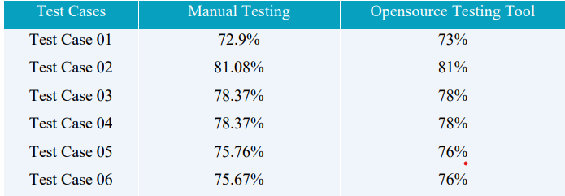
Statement Testing Results
Almost the same!!

Slide 16
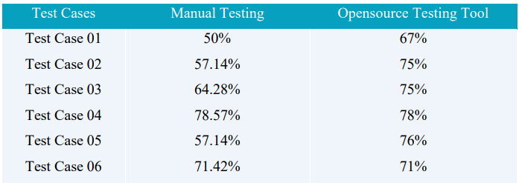
Branch Testing Results
It is not the same!! Why?

Slide 17
Any Question
Thank You!

